Slide 1
Analyzing Toronto Boroughs To Determine Business Venue Locations

Slide 2
Background
Toronto also is among the leading financial industry center in Northern America
Toronto has six neighborhood districts also known as Boroughs, from each borough contains 140 official neighborhoods that are recognized by the city
Determine the neighborhood that returns the highest business venue to recommend the business categories for investors

Slide 3
Data Acquisition and Cleaning
Data Scraping from Wikipedia using Beautiful Soup python library
In total of 180 rows and 2 columns from raw data
After cleaning there are 103 rows and 3 columns
Duplicate Postal code with same Borough and Neighborhood were merged

Slide 4
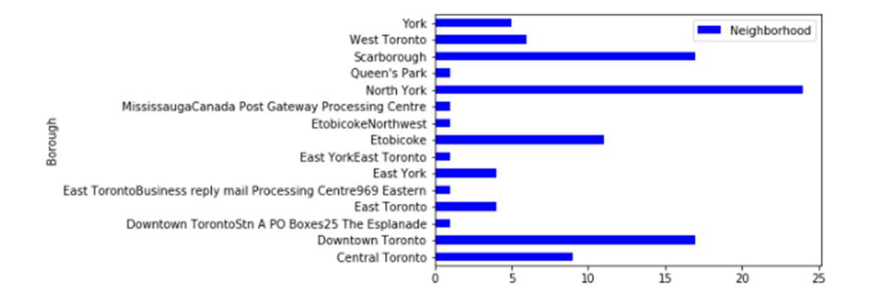
Methodology
Geocoder
used to download the latitude and longitude for each postal code
Three Borough with highest Neighborhood
Downtown Toronto
North York
Scarborough

Slide 5
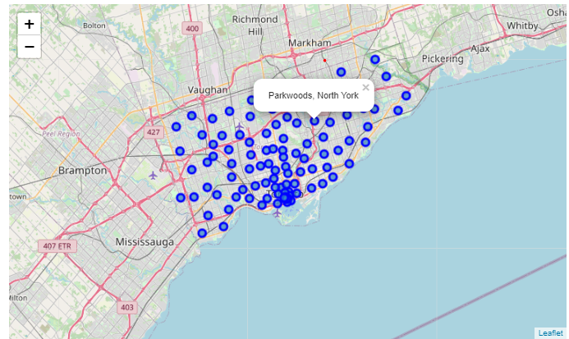
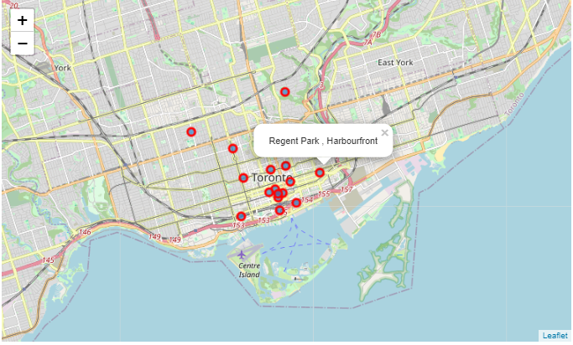
Folium
Toronto Boroughs and Neighborhood
Folium used to display the location of the borough and their neighborhood on the map
Total of 131 Boroughs
Geographical location of Downtown Toronto
Total of 17 neighborhoods
Downtown Toronto

Slide 6
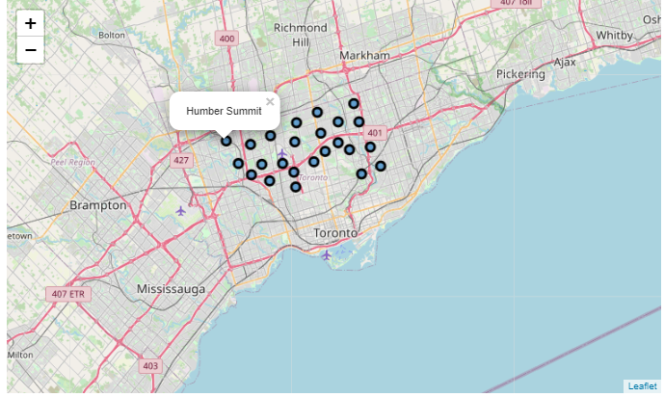
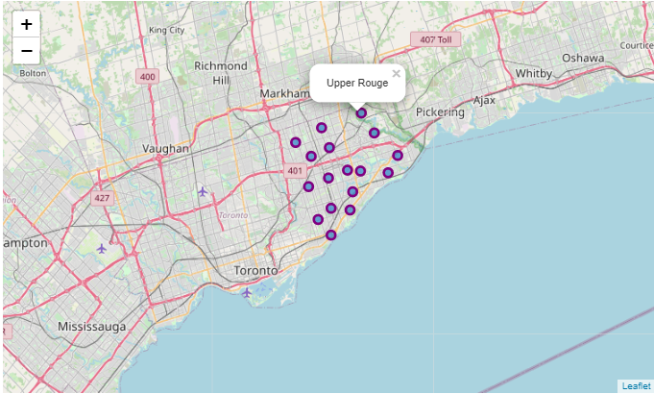
Folium
North York
Geographical location of North York on the map
Total of 23 neighborhoods
Geographical location of Scarborough on the map
Total of 17 neighborhoods
Scarborough

Slide 7
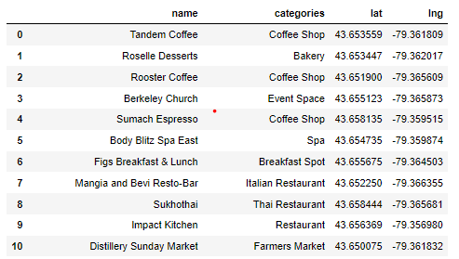
Result
Downtown Toronto
Categories of business venues returned
Downtown Toronto
Returned 88 venues
Most occurred in the category is the coffee shop

Slide 8
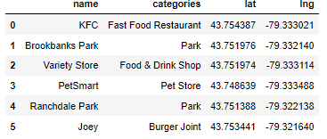
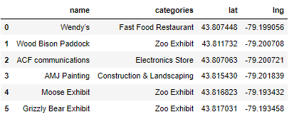
Result (North York & Scarborough)
North York
Categories of business venues returned
North York
Returned 5 venues
Scarborough
Returned 5 venues
Scarborough

Slide 9
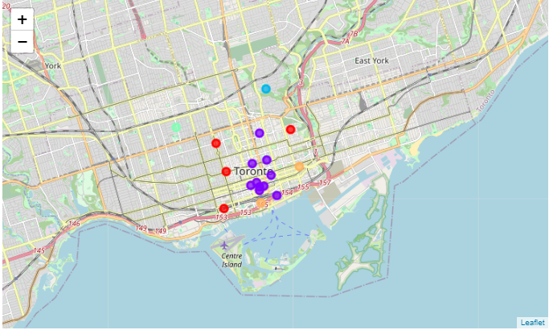
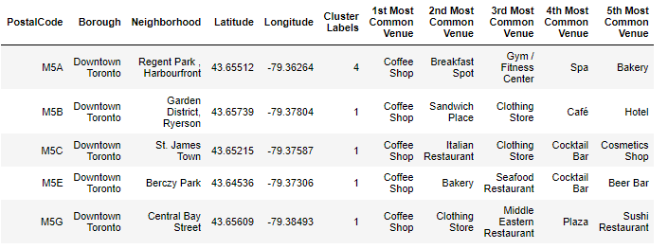
K-Means Clusters
Downtown Toronto Neighborhood Clusters
First five most common venue
Cluster label mostly in the first cluster
Downtown Toronto Most Common Venue

Slide 10
Discussion
The analysis can give the business investor on what type of business and location where businesses are less competitive and fast-growing
I used K-Means algorithm, setting the optimum k value to 5, considering 17 Downtown Toronto Neighborhoods
88 venues from downtown Toronto return after using foursquare API

Slide 11
Conclusion & Future Directions
Prediction model are not used so I could not make any final inferences which is the best location but suggested to have business in the neighborhood that return most venues.
Regression models can be used to analyze the average housing price differences in the future
For more analysis insight, the cost of housing can be investigated according to their postal code for new residents or immigrants.

